Slide 1
DESIGN and ANALYSIS of ALGORITHMS HIMANSHU SRIVASTAVA CSE 2nd Year Roll no. : 181220031

Slide 2


Graphs :
DFS & BFS

Slide 3
GRAPH SEARCHING
Problem
Find a path between two nodes of the graph.
Solution
There are mainly two methods :-
1. Depth-First-Search ( DFS )
2. Breadth- First-Search (BFS )

Slide 4
DEPTH FIRST SEARCH

Slide 5
DEPTH FIRST SEARCH (DFS)
What is the idea behind DFS?
* Travel as far as you can down a path
* Back up as little as possible when you reach a "dead end"
(i.e., next vertex has been "marked" or there is no next vertex).
DFS can be implemented efficiently using a stack

Slide 6
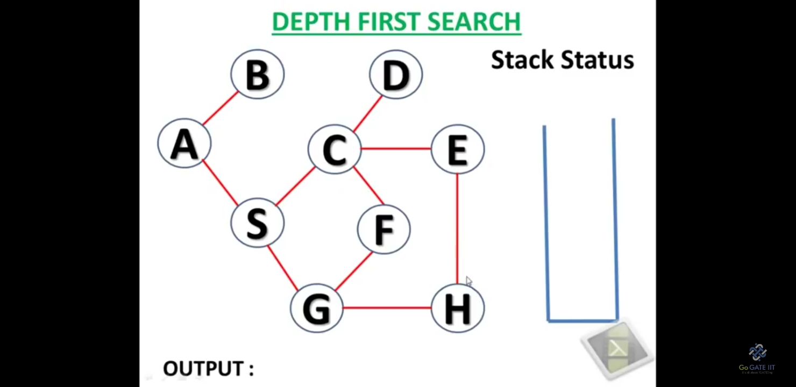
DFS Example

Slide 7
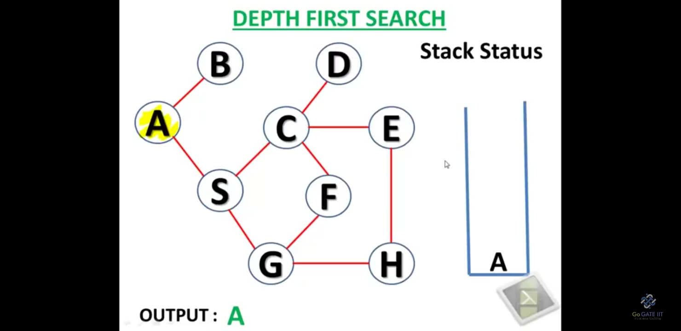
DFS Example

Slide 8
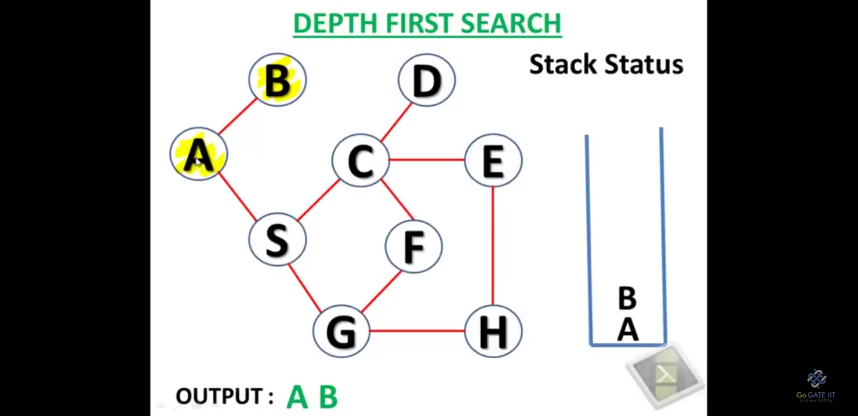
DFS Example

Slide 9
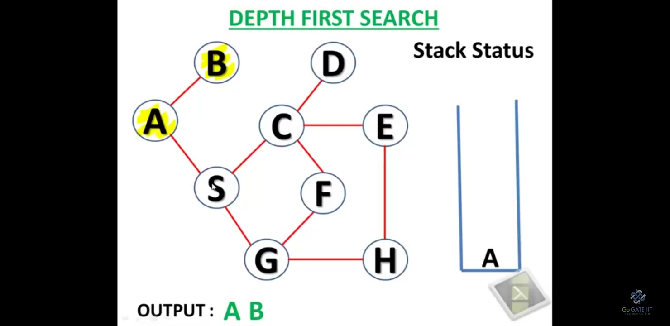
DFS Example

Slide 10
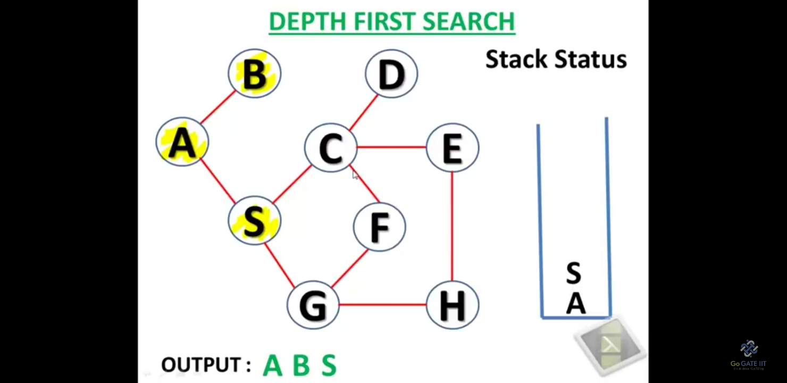
DFS Example

Slide 11
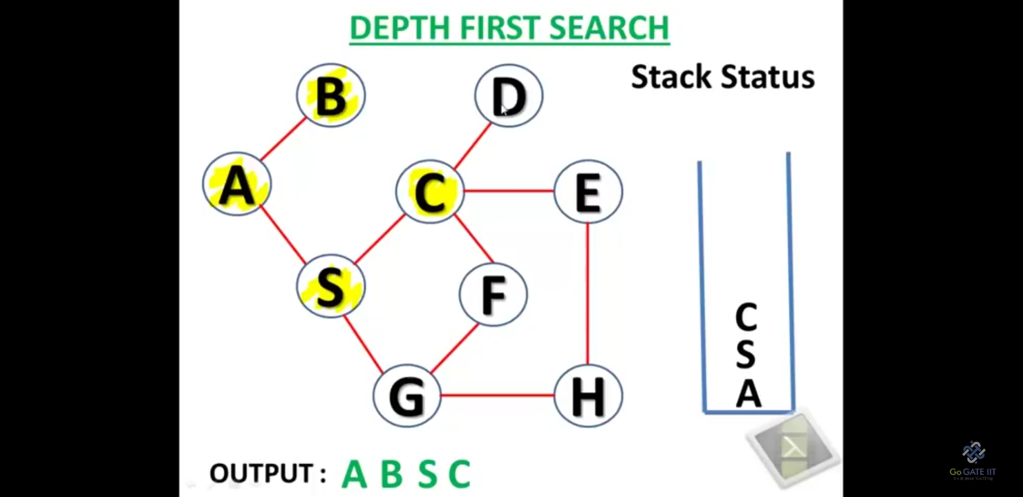
DFS Example

Slide 12

DFS Example

Slide 13
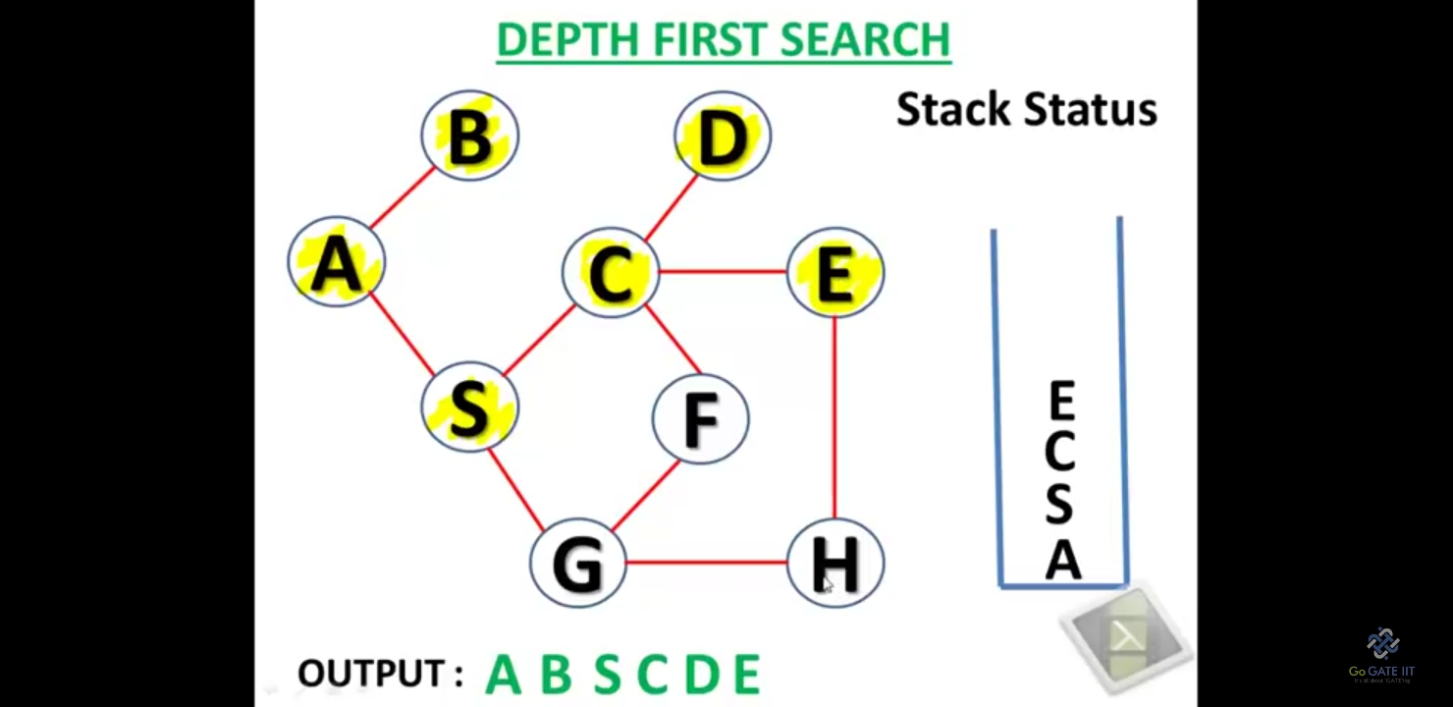
DFS Example

Slide 14
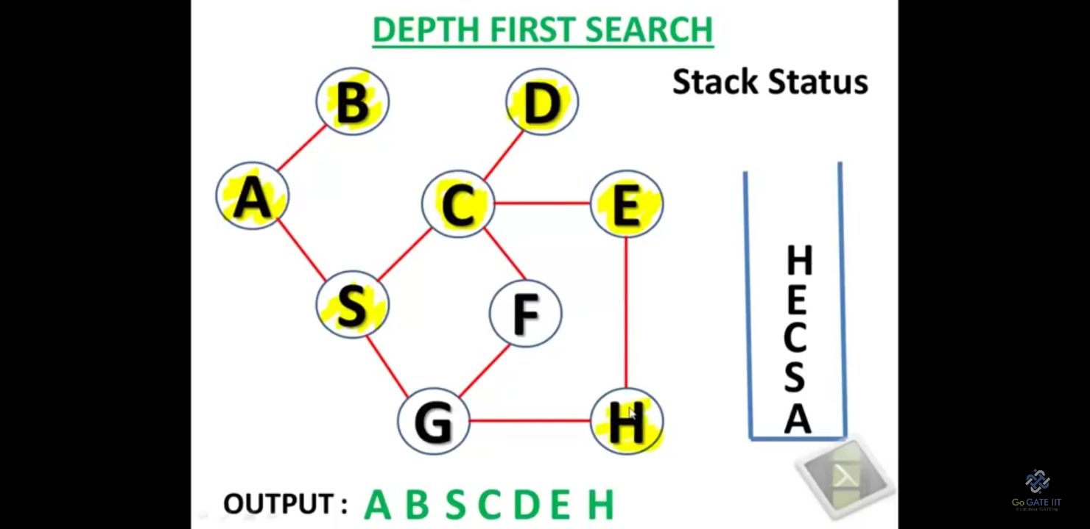
DFS Example

Slide 15
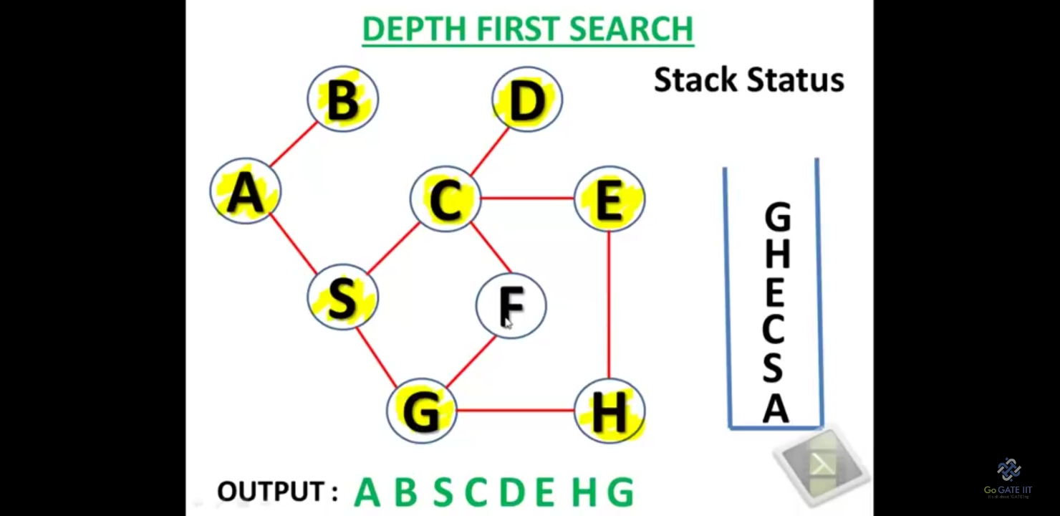
DFS Example

Slide 16
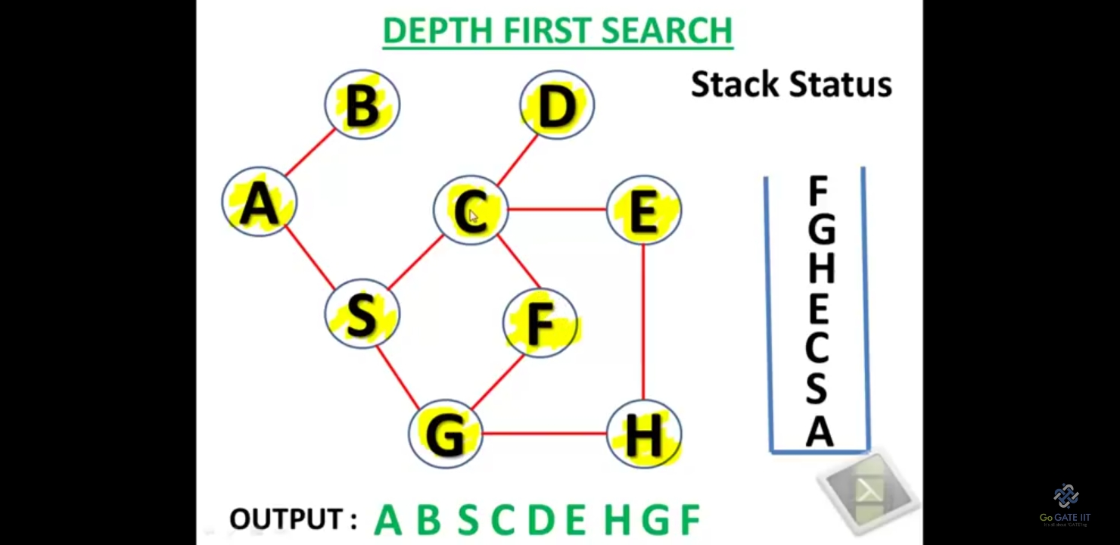
DFS Example

Slide 17
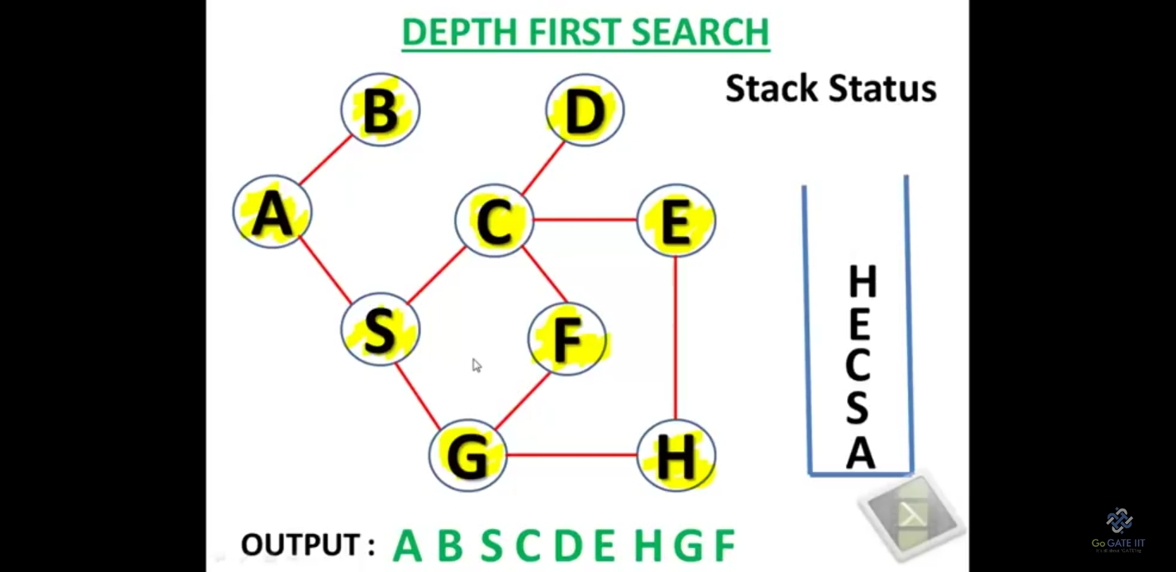
DFS Example

Slide 18

DFS Example

Slide 19

DFS Example

Slide 20
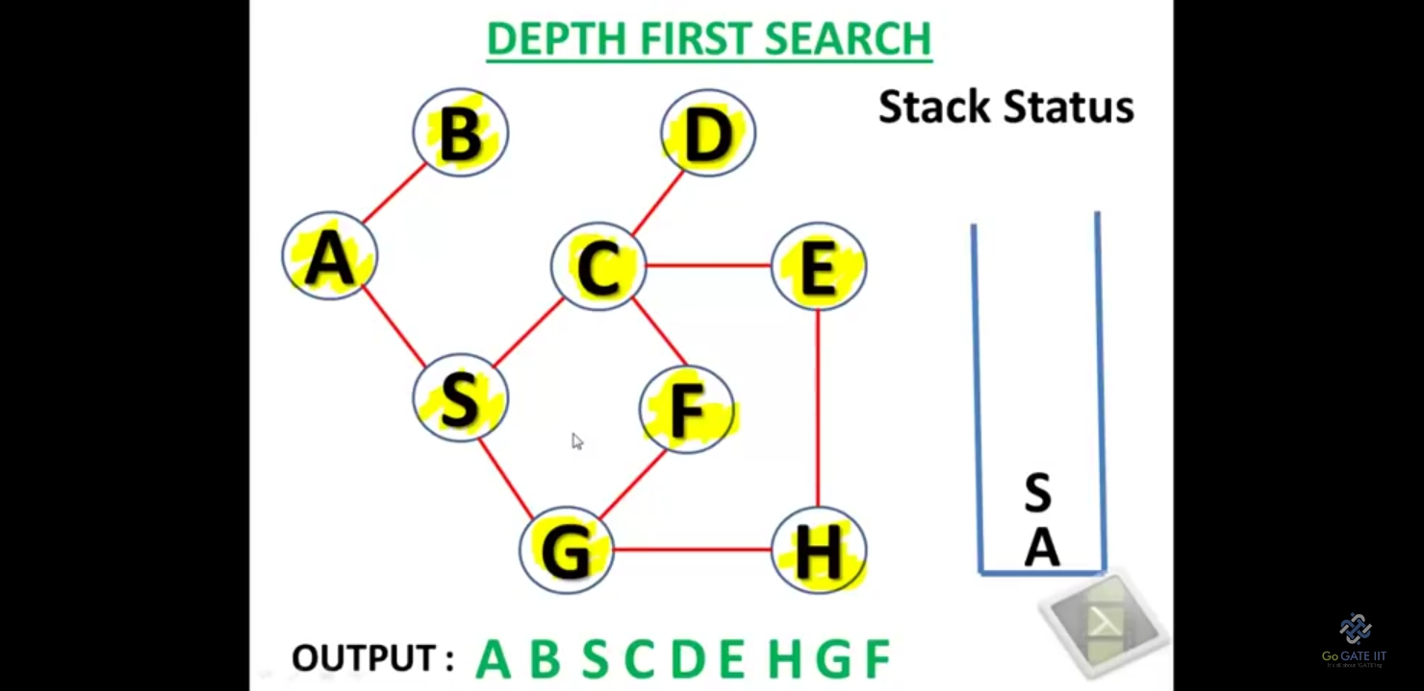
DFS Example

Slide 21
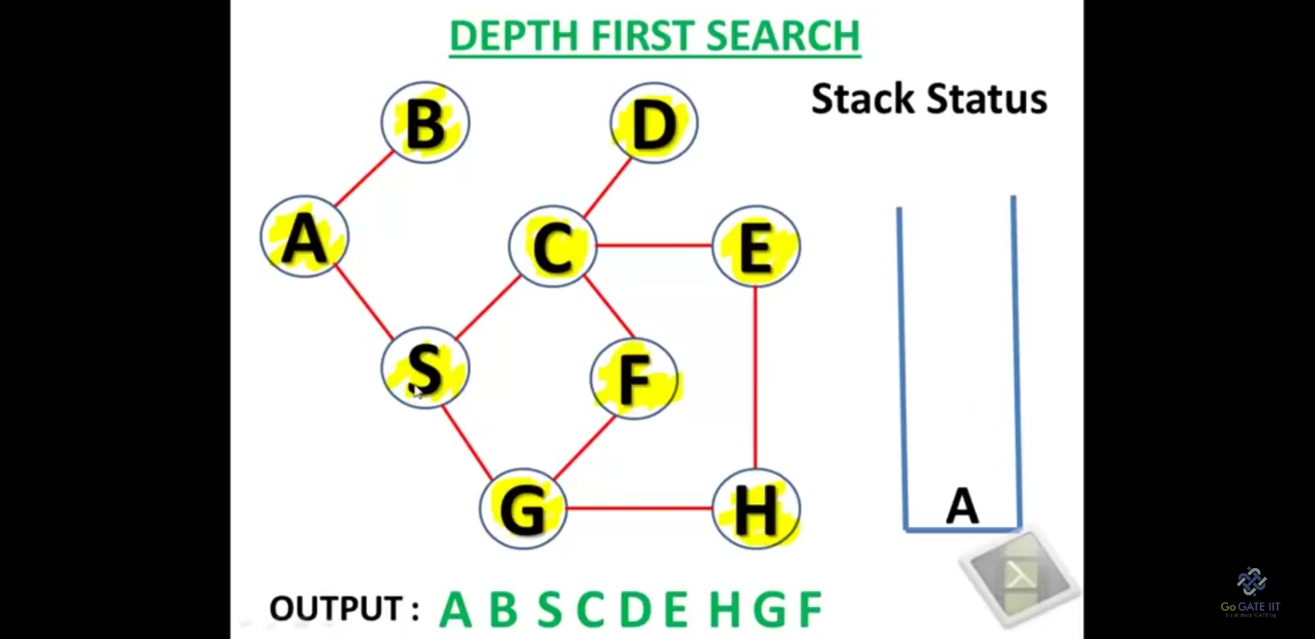
DFS Example

Slide 22
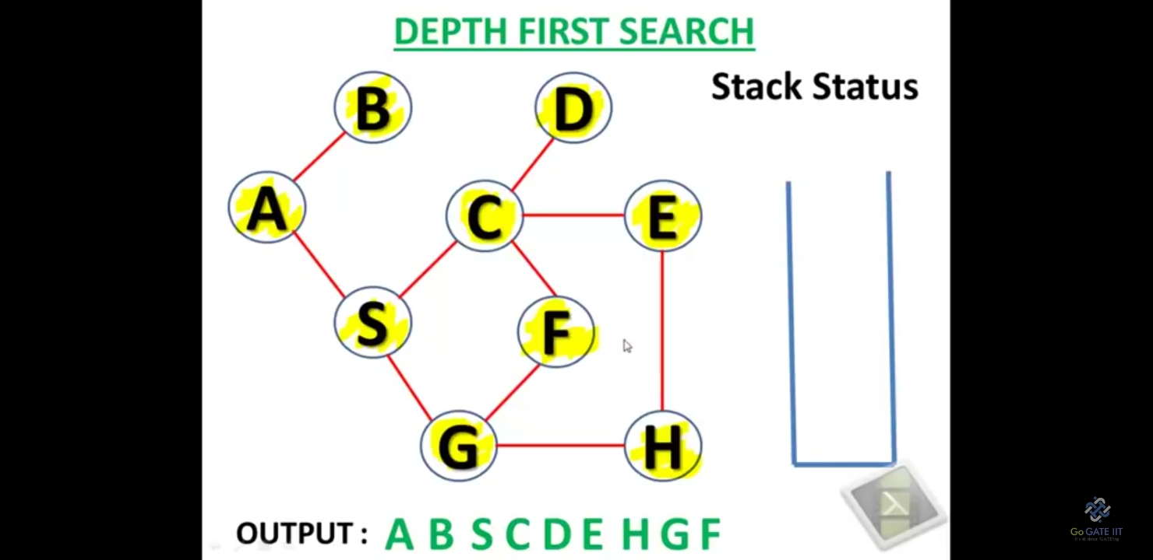
DFS Example

Slide 23
BREADTH FIRST SEARCH

Slide 24
BREADTH FIRST SEARCH (BFS)
What is the idea behind BFS?
* Look at all possible paths at the same depth before you go at a deeper level.
* Back up as far as possible when we reach a “ dead end “. (i.e., next vertex has been "marked" or there is no next vertex).
BFS can be implemented efficiently using a queue.

Slide 25
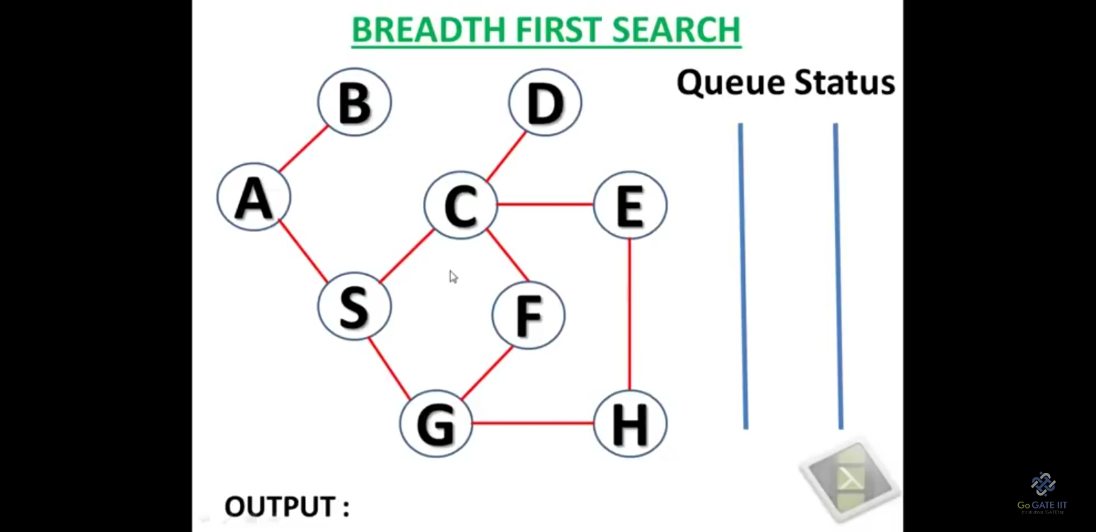
BFS Example

Slide 26
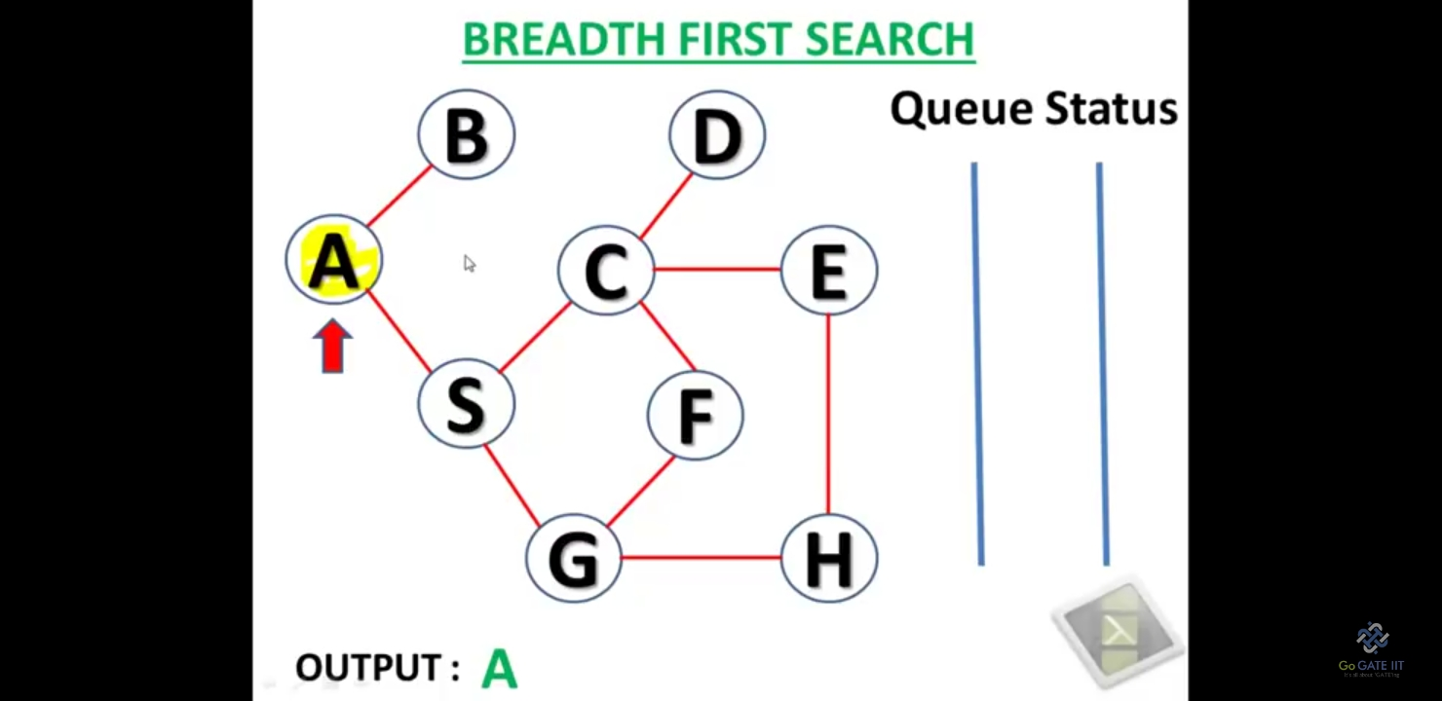
BFS Example

Slide 27
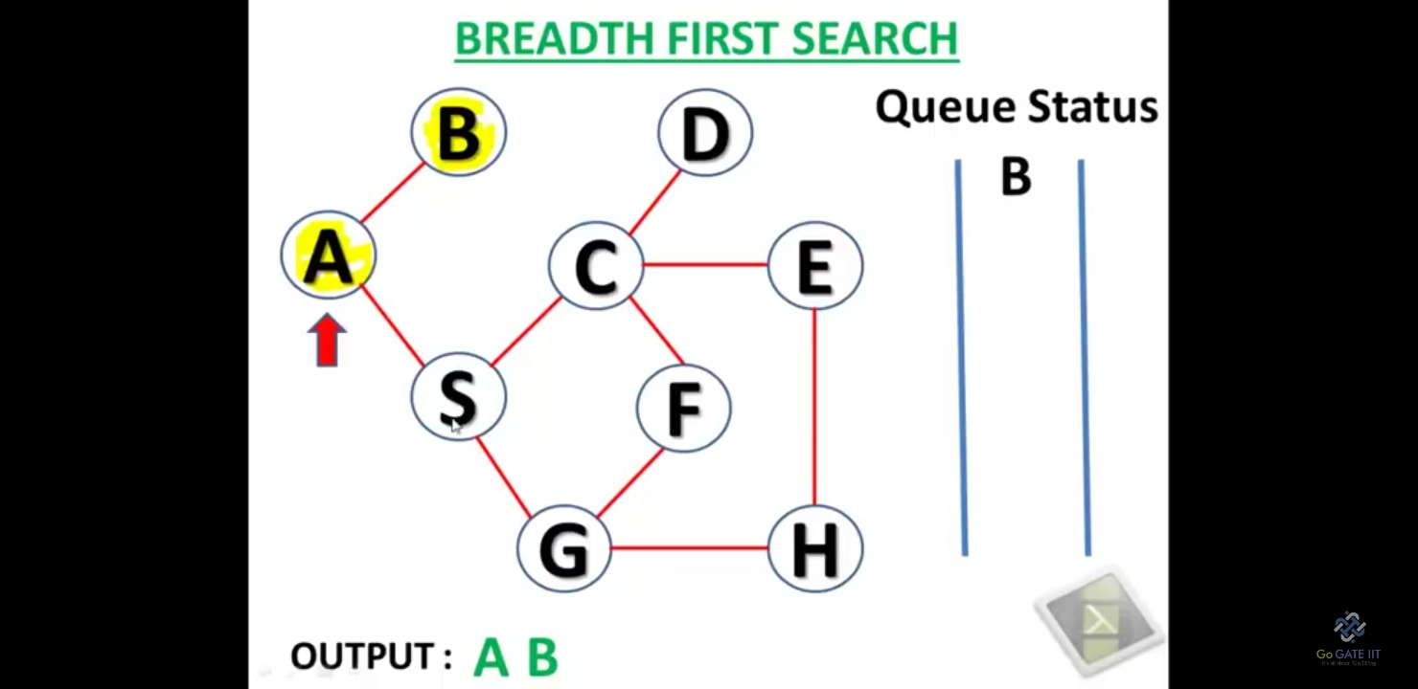
BFS Example

Slide 28
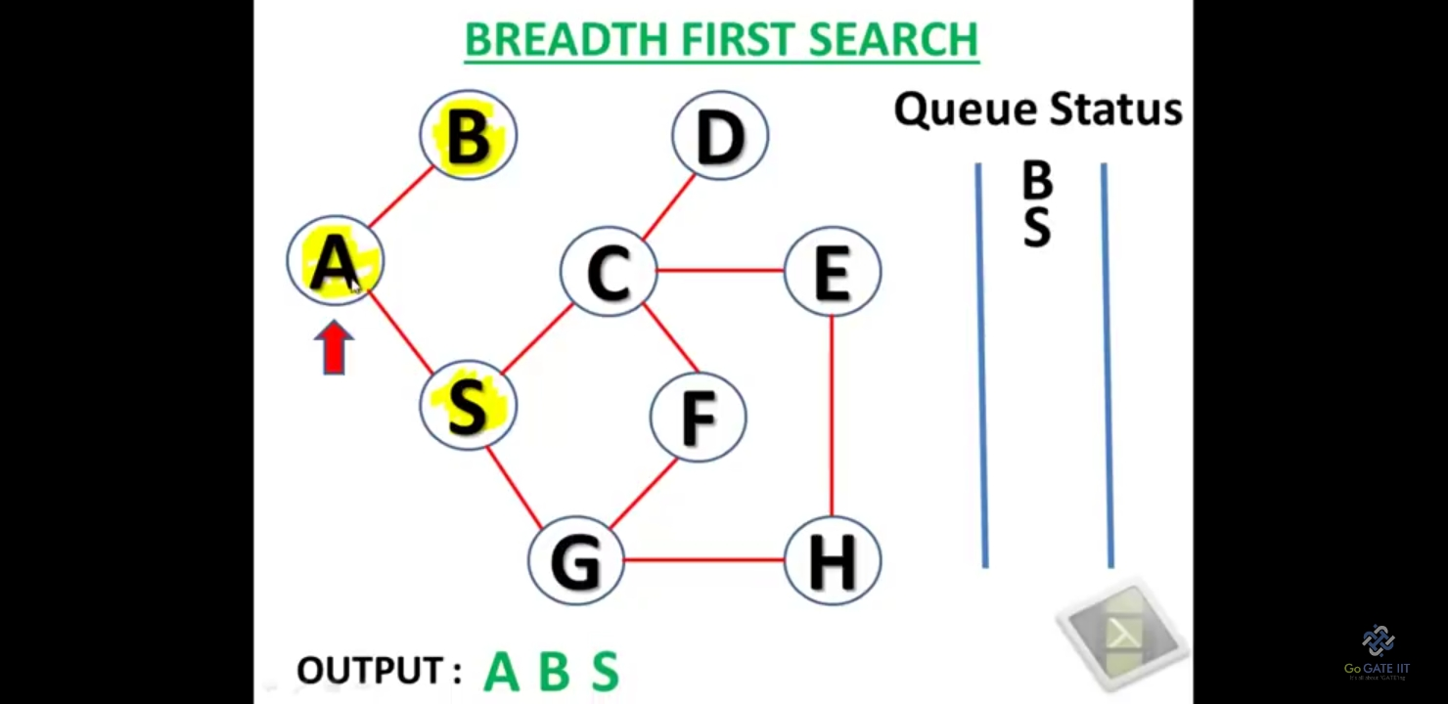
BFS Example

Slide 29
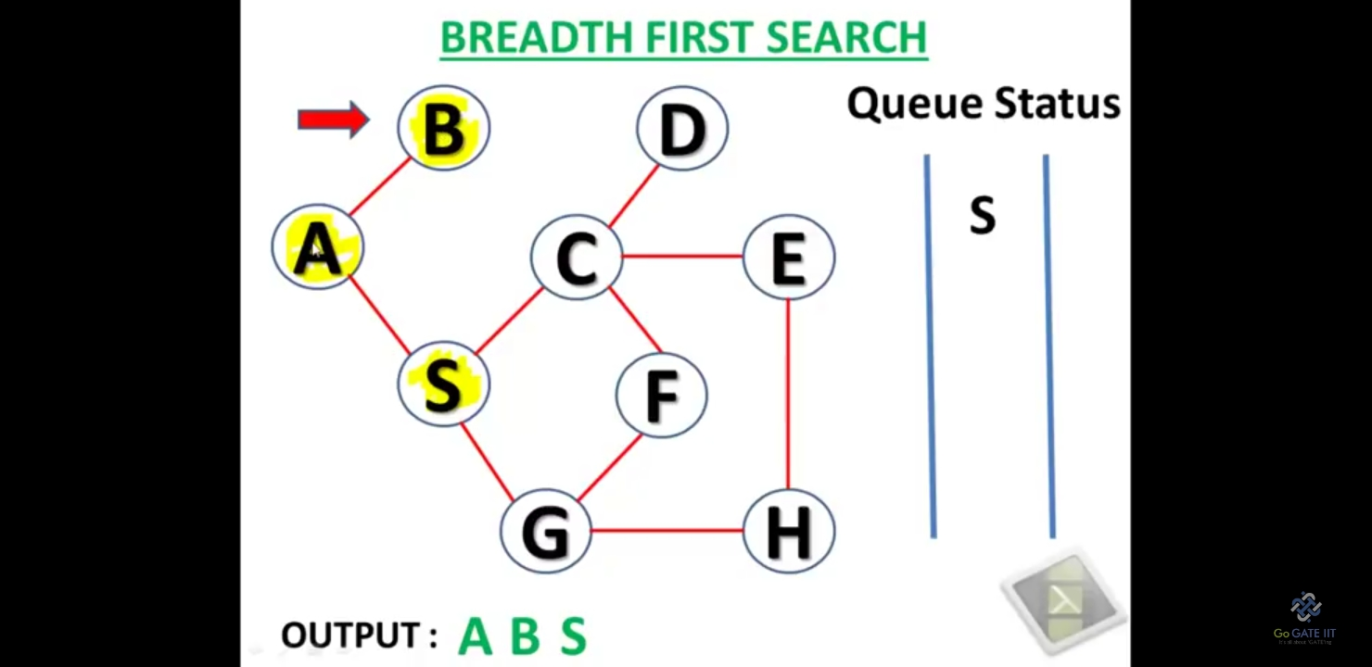
BFS Example

Slide 30
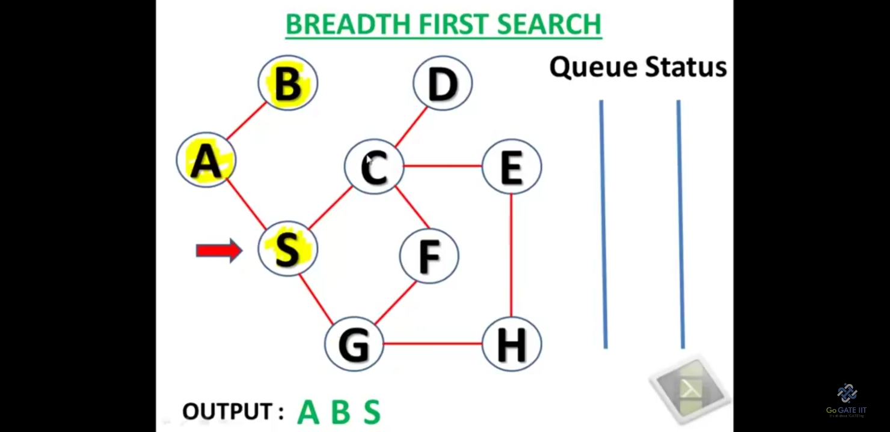
BFS Example

Slide 31
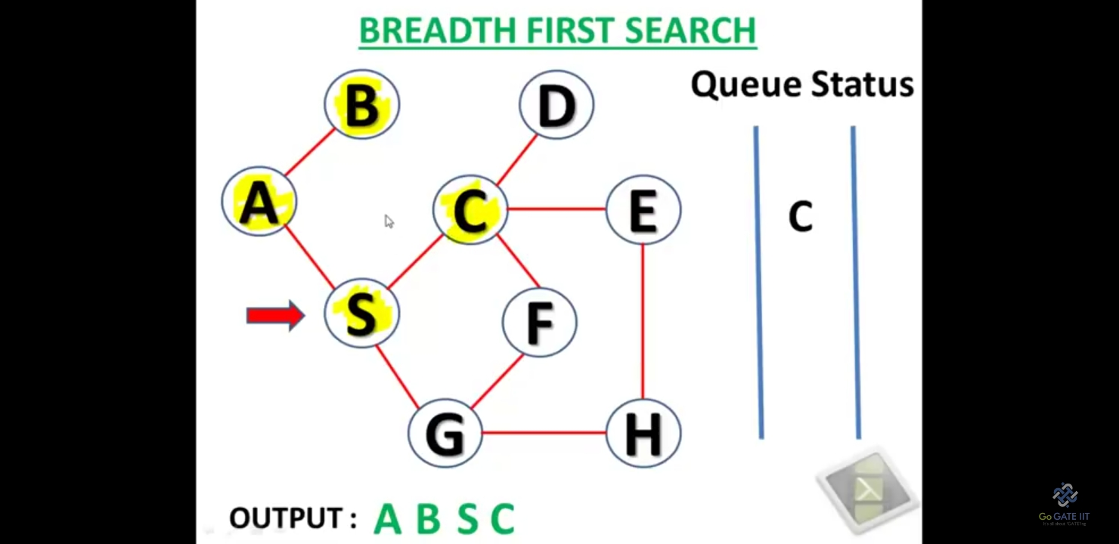
BFS Example

Slide 32
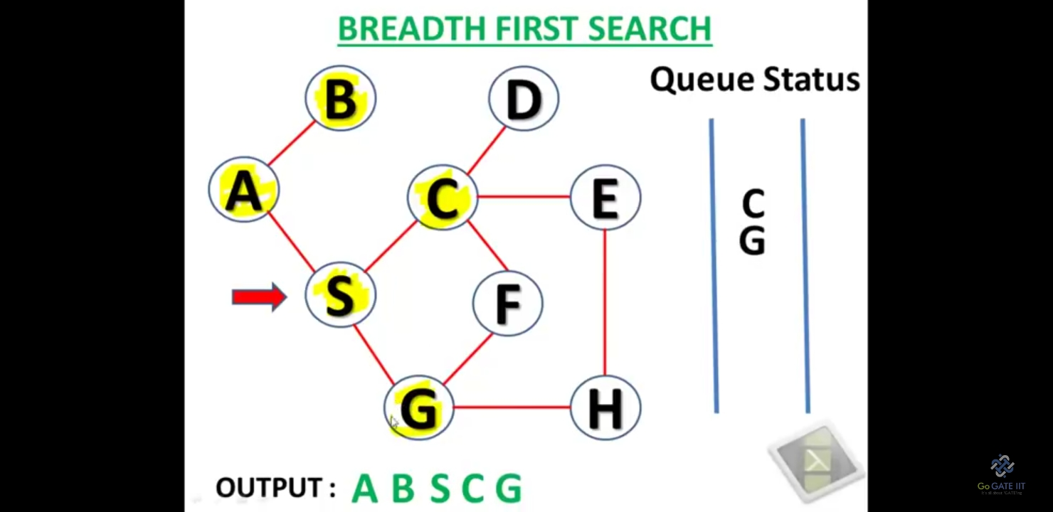
BFS Example

Slide 33
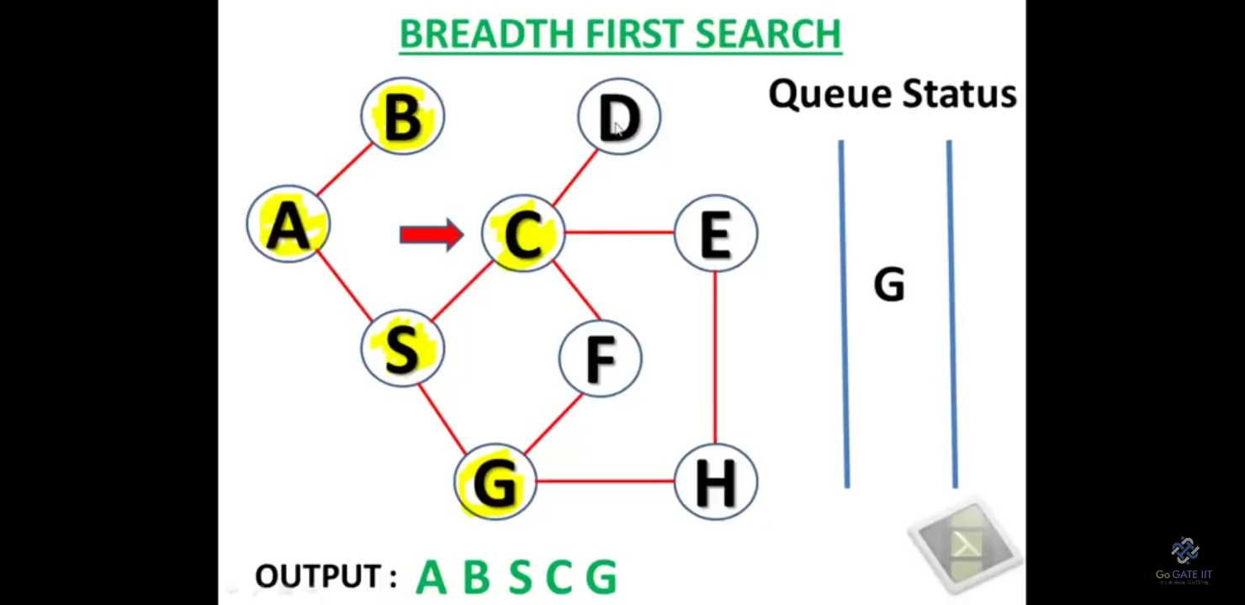
BFS Example

Slide 34
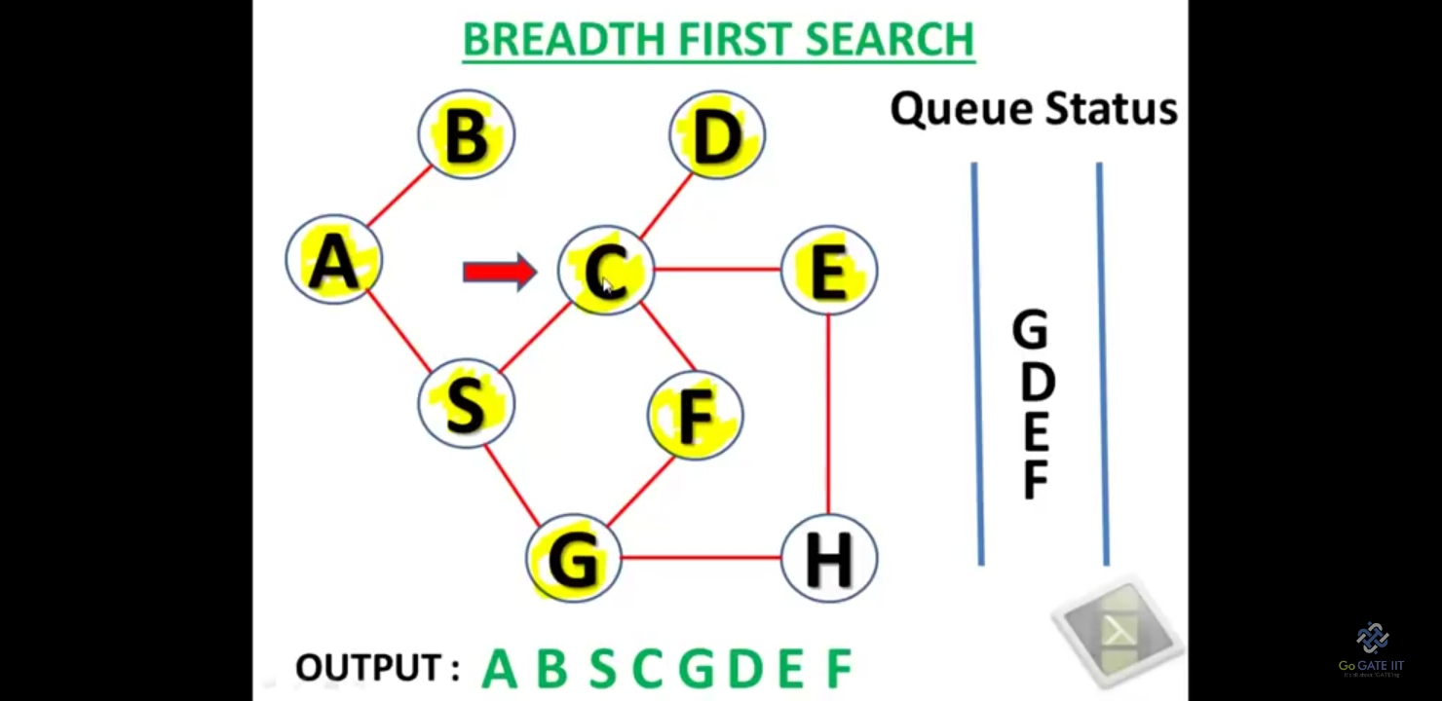
BFS Example

Slide 35
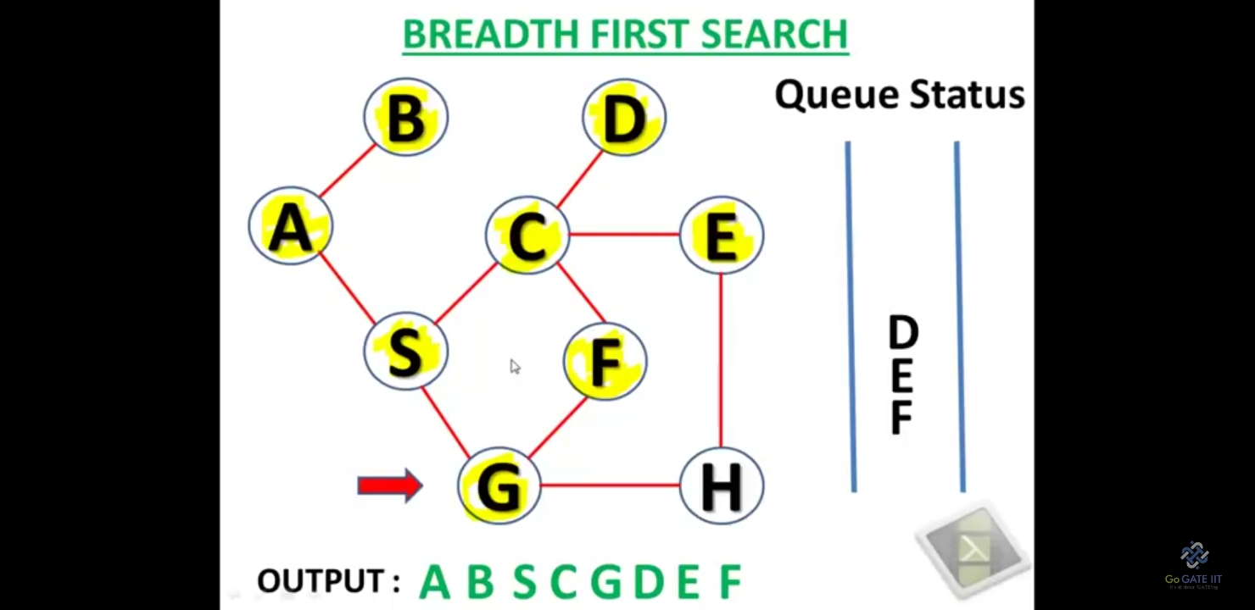
BFS Example

Slide 36
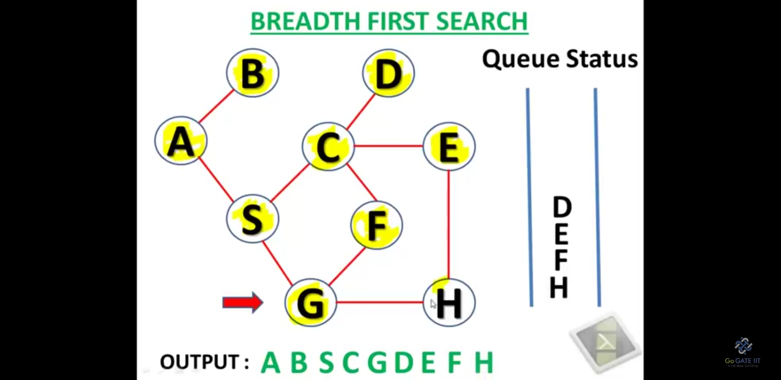
BFS Example

Slide 37
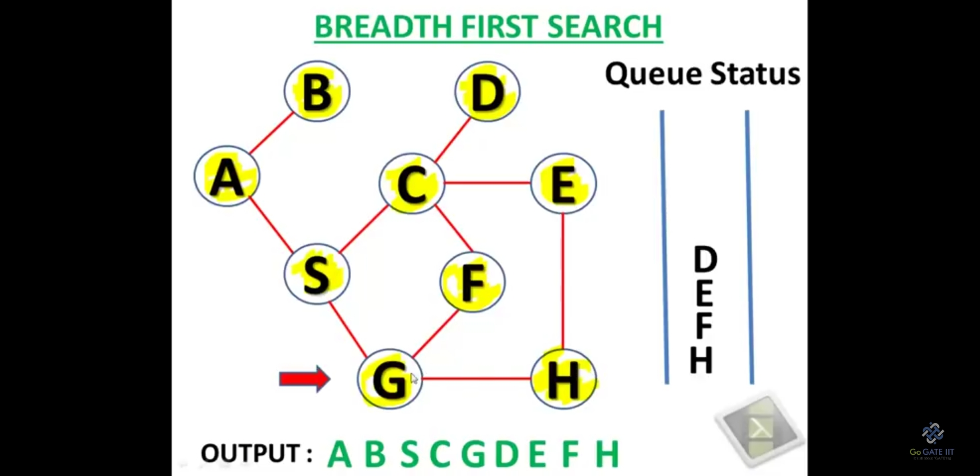
BFS Example

Slide 38
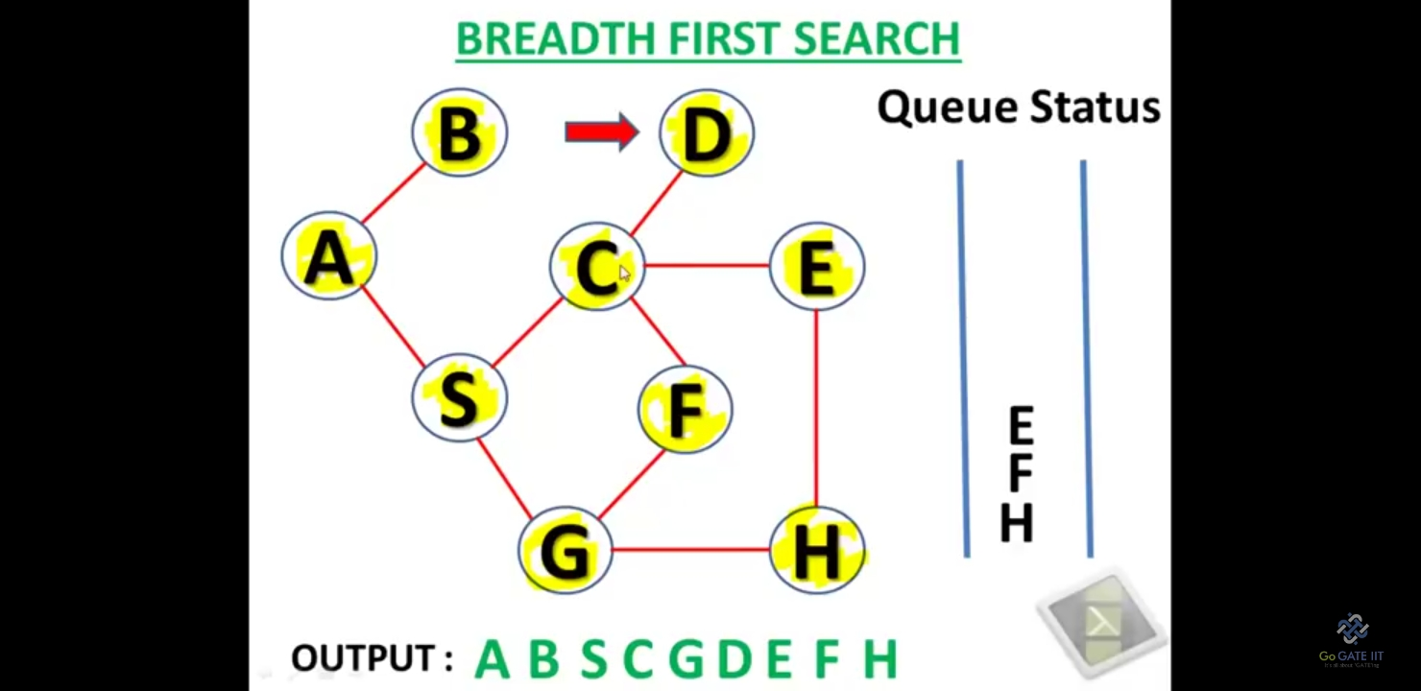
BFS Example

Slide 39
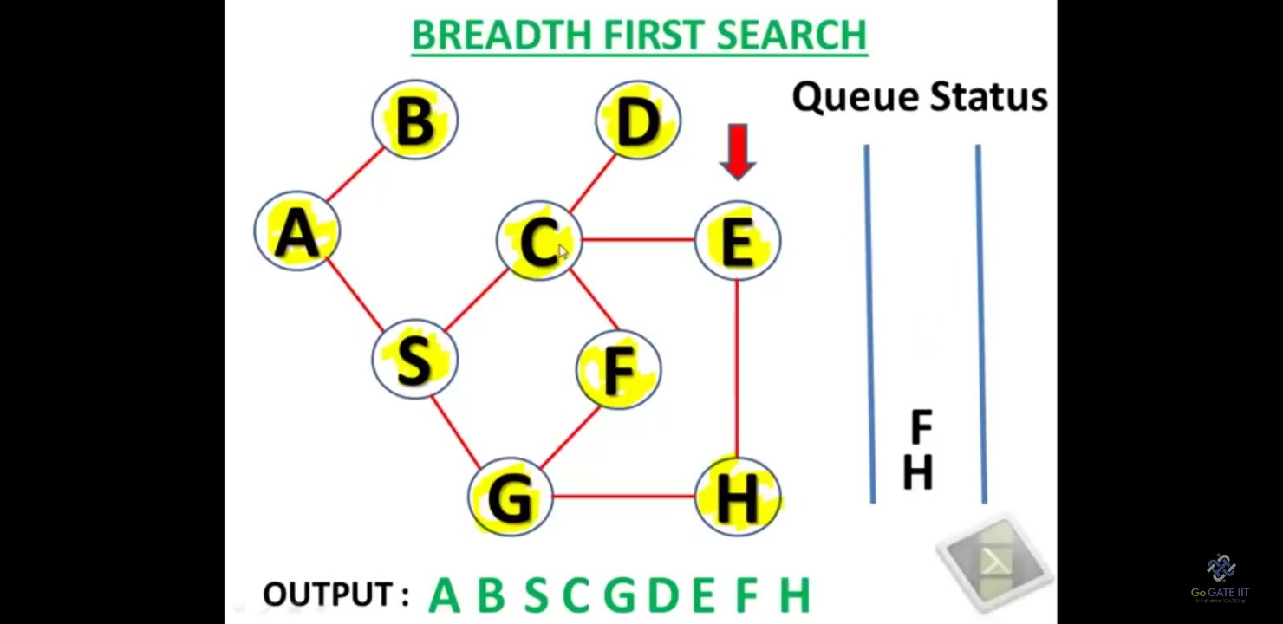
BFS Example

Slide 40
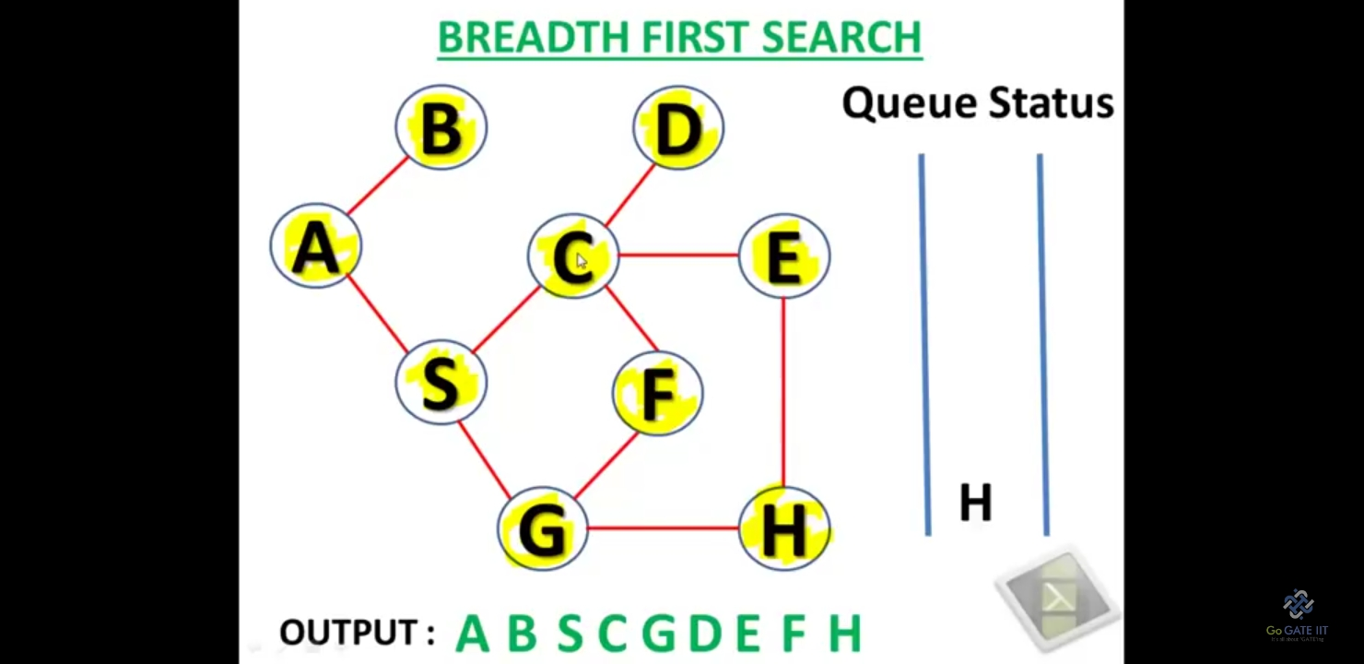
BFS Example

Slide 41
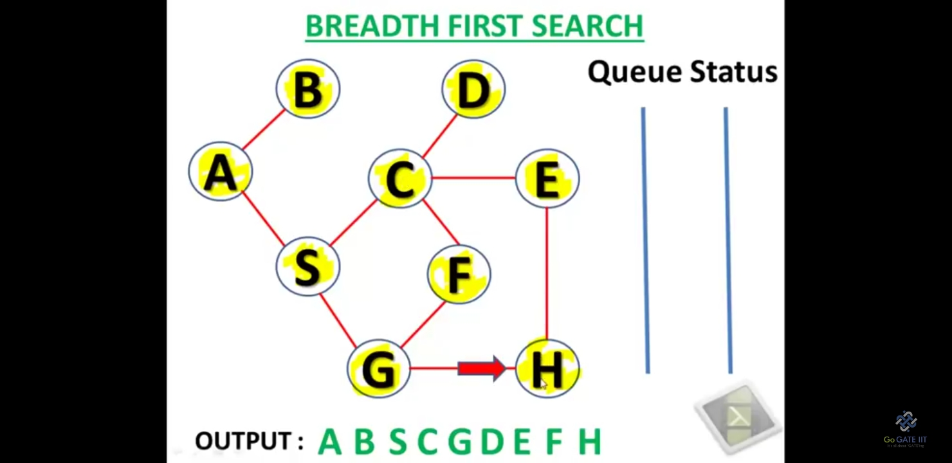
BFS Example

Slide 42
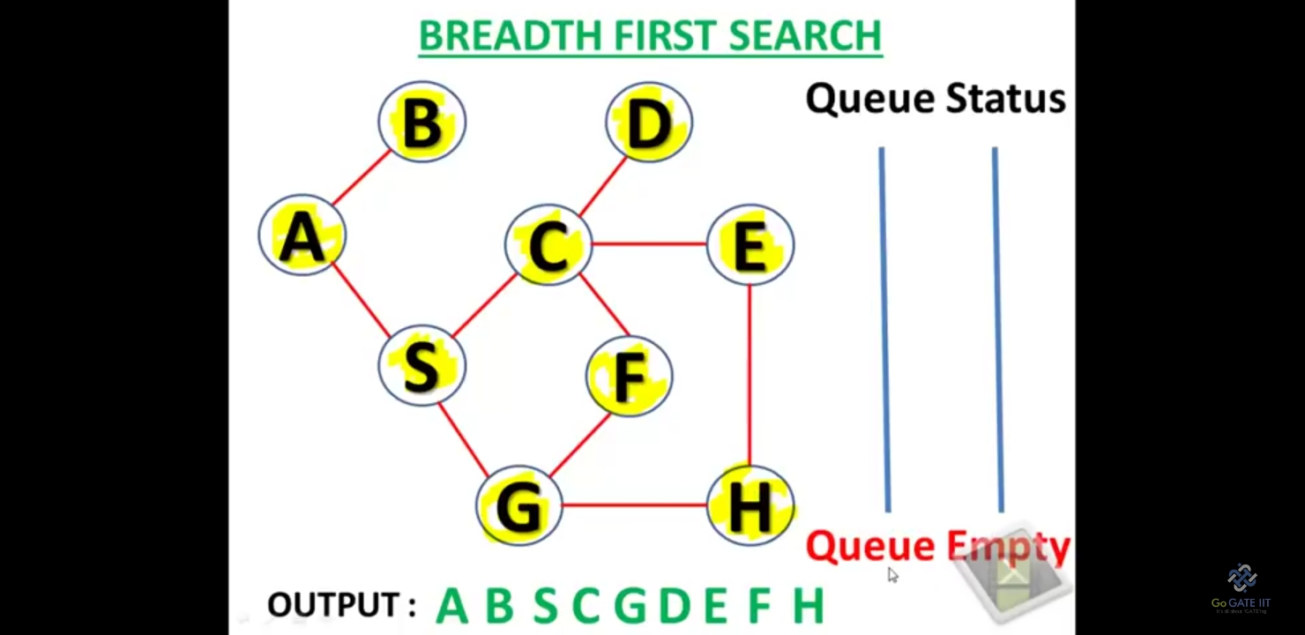
BFS Example

